Slide 1
Police Brutality
Terry Mullin, Madelyn Mathai,

Slide 2
Why we selected police brutality?
Present-day conflicts of equality vs. equity
We decided to relate the difference between equity and equality using data on police violence against minorities
We will use machine learning to see if it can predict the race of an individual killed by police using multiple variables such as: if armed, fleeing from police, age,
We want to see if the individuals killed by police were indeed a threat, or were the killings race driven

Slide 3
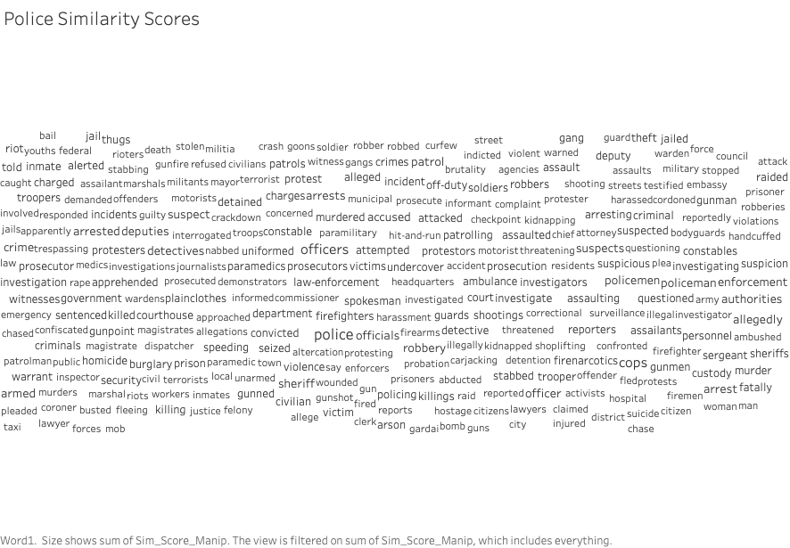

Slide 4
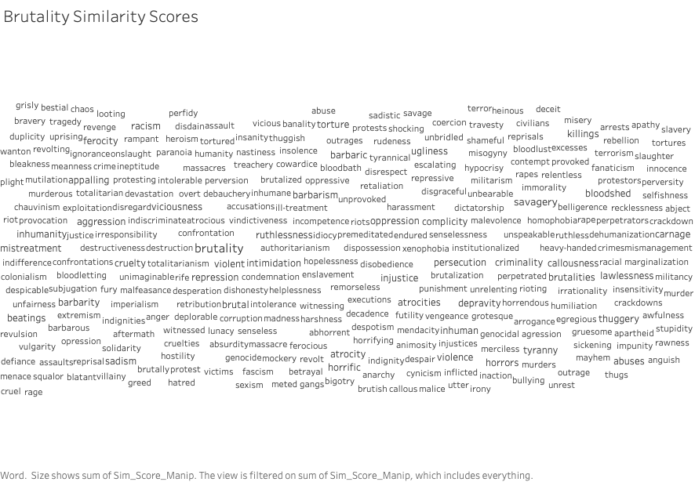

Slide 5
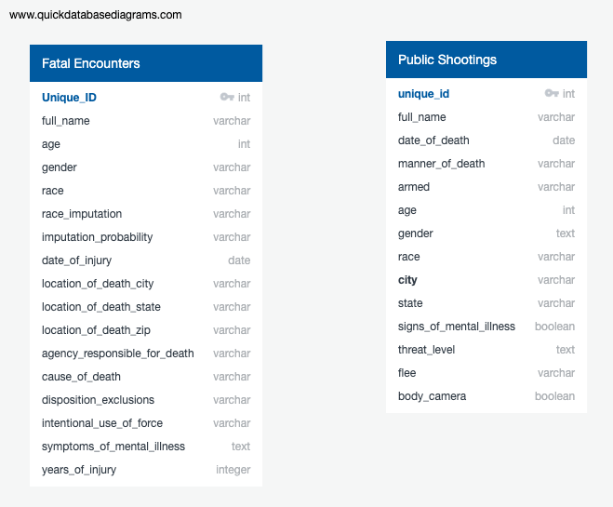
Data Sources

Slide 6
Questions We Hope to Answer?
In the first portion we want to see if the individuals killed by police were indeed a threat, or were the killings race driven
In the second portion of the project we want to explore conceptual similarities scores across relevant words we have chosen using Natural Language Processing (NLP), heavily drawing from machine learning and AI models GloVe (GLobal Vectors for Word Representation) and spaCy

Slide 7
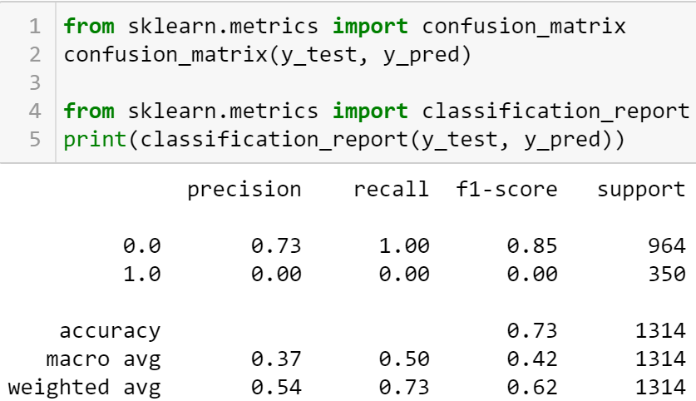
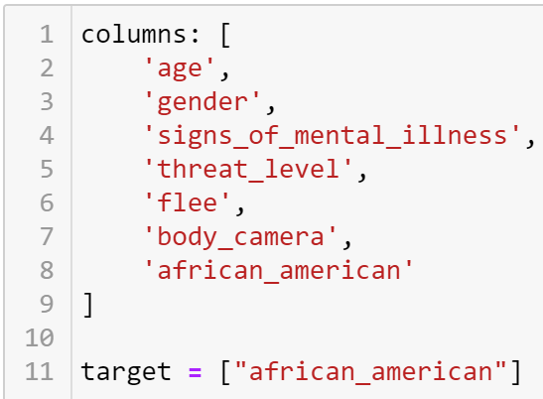
Data Exploration Phase

Slide 8
Analysis Phase
We used age, gender, signs of mental illness, threat level, fleeing, and if body cameras were worn by police as variables to determine if our model could predict if the person killed was African American.
We used a Support Vector Machine (SVM) model for our dataset to compare the true/false value of the individual being African American vs. the rest
SQL tables using PGadmin were used to prepare our data for the machine learning model. The tables created will be 'age’, ‘gender’, ‘signs of mental illness’, ‘threat level’, ‘fleeing’, and if ‘body cameras’ were worn by police, for our table. We're still figuring out the exact joins and we will then export the combined SQL query as one csv file.

